Slide 1



Studypilot

Slide 2

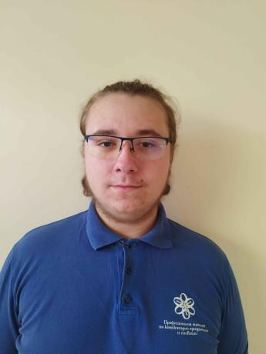
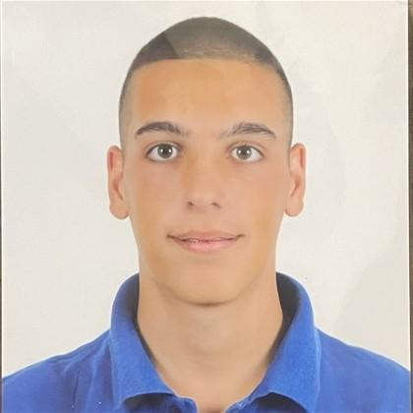

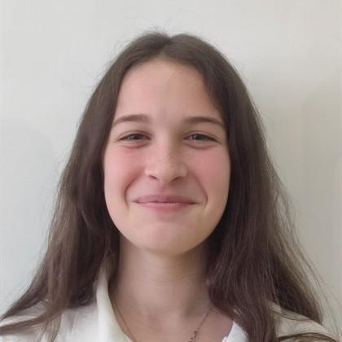
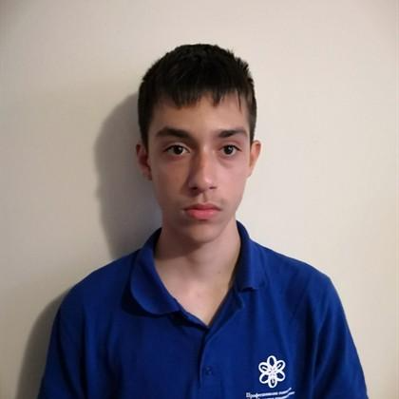
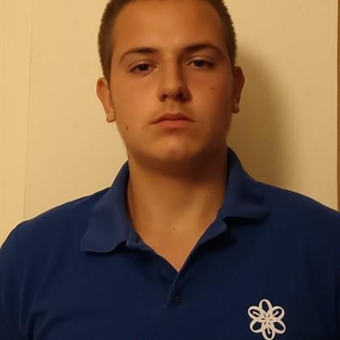
OUR TEAM

Slide 3

THE IDEA
Our Flask-based web app is a social platform that connects users with personalized internship opportunities using machine learning. Users can create profiles, register companies, and receive tailored internship matches based on a questionnaire and logistic regression model.

Slide 4
STAGES OF REALISATION
01
02
03
04
We’ve met up with the task and we’ve chosen how our site will work
We made a group and split the roles between us
Finally, we checked if there were any bugs and if everything worked.
We did the main menu and then step by step the whole site

Slide 5







USED TECHNOLOGIES

Slide 6

THANKS FOR YOUR ATTENTION, NOW LET’S MOVE TO THE SITE!

